Slide 1
WP3 - Model to/from Knowledge Base Synchronization Mechanism
Ferhat Erata, Work Package Leader
UNIT Information Technologies R&D Ltd.

Slide 2
Technological components & interactions Colloboration by WP interactions
Tarski
Notes:
These are the building Blocks of ModelWriter. As you can see, there exists strong dependency between components which results collaboration not only inside a work package but also other WPs.

Slide 3
Tarski: A Platform for Automated Analysis of Dynamically Configurable Semantics of Traceability

Slide 4
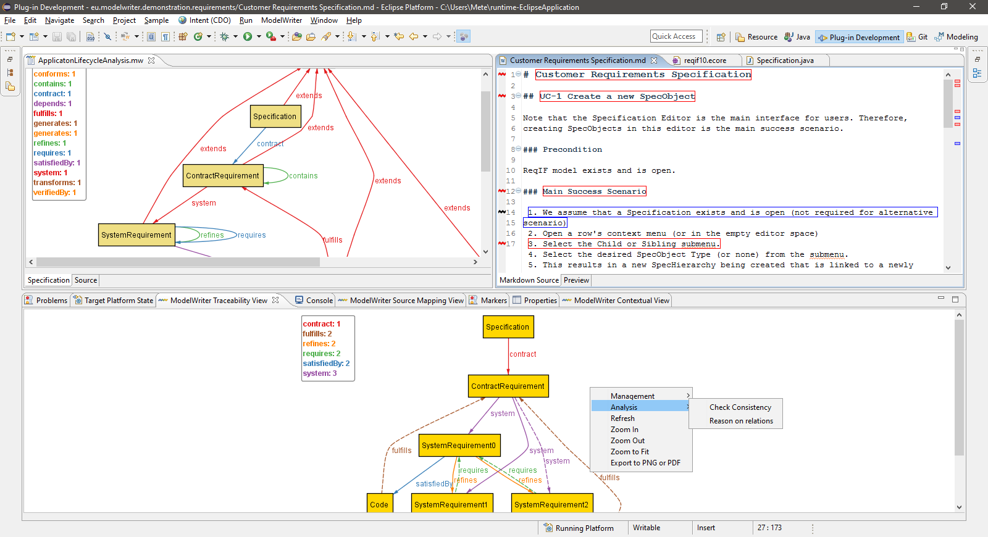
Technical Contributions @Tarski

Slide 5
Challenges of Traceability in Industry
Semantically meaningful traceability
traceability relations should have a rich semantic meaning instead of being simple bi-directional referential relation
Configurability of traceability (possibly dynamically)
the semantics of traceability elements is often statically defined
the semantics cannot be easily adapted for the needs of different projects.
different traceable elements and the types of relations exist in industrial settings.
Several industries demands formal proofs of traceability
Consistency checking and repairing broken trace links
Notes:
SIDP is used (under Non Disclosure agreement) as a use case

Slide 6
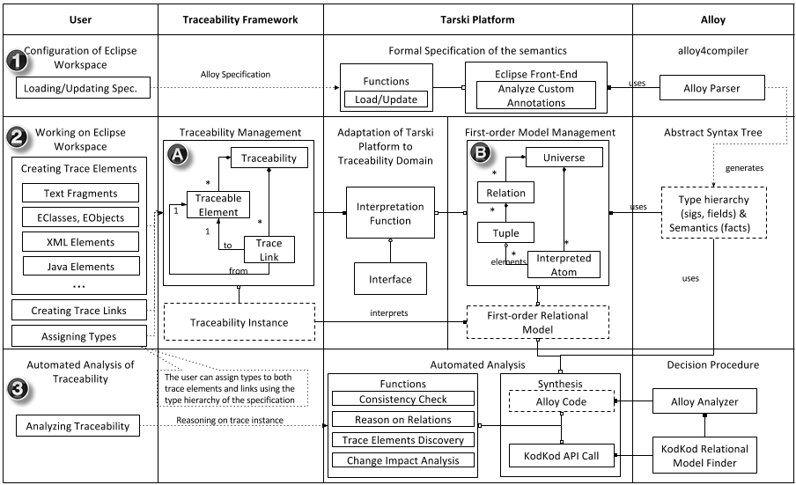
Tarski Approach
Notes:
Simplified version of actual architecture, there is a striking resemblance between planned and actual ones which means logical decomposition of project based on fucntions corresponds the real architecture.

Slide 7
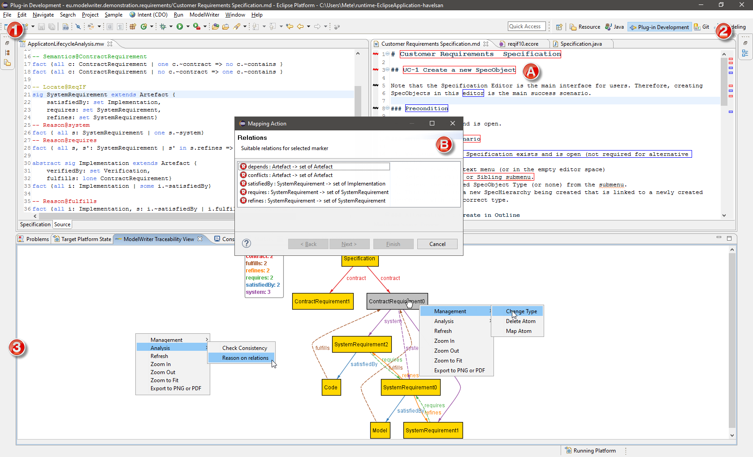
Tarski Approach
Notes:
Simplified version of actual architecture, there is a striking resemblance between planned and actual ones which means logical decomposition of project based on fucntions corresponds the real architecture.

Slide 8
Overview of Technical Contributions @Tarski
Technical Workpackages
Semantic Domain (Traceability)
Formal Specification & Formal Semantics
Traceability Management
Traceability Visualization
Locations
Links
Traceability Data-Model
Automated Analysis
First-order Logic
Axioamatic Set Theory
Relational Calculus
Syntax (Formalism)

Slide 9
Traceability Analysis
Traceability Analysis
Change Impact Analysis
Reasoning about trace relations
Consistency checking
Automated Tracebility Link Creation
Automated Reasoning
Between Modeling Languages
Multi-model Consistency Checking
Location discovery
Dynamical Configurability of Specification
Scalability
Integration of Efficient Decision Procedures
Incremental Approach

Slide 10
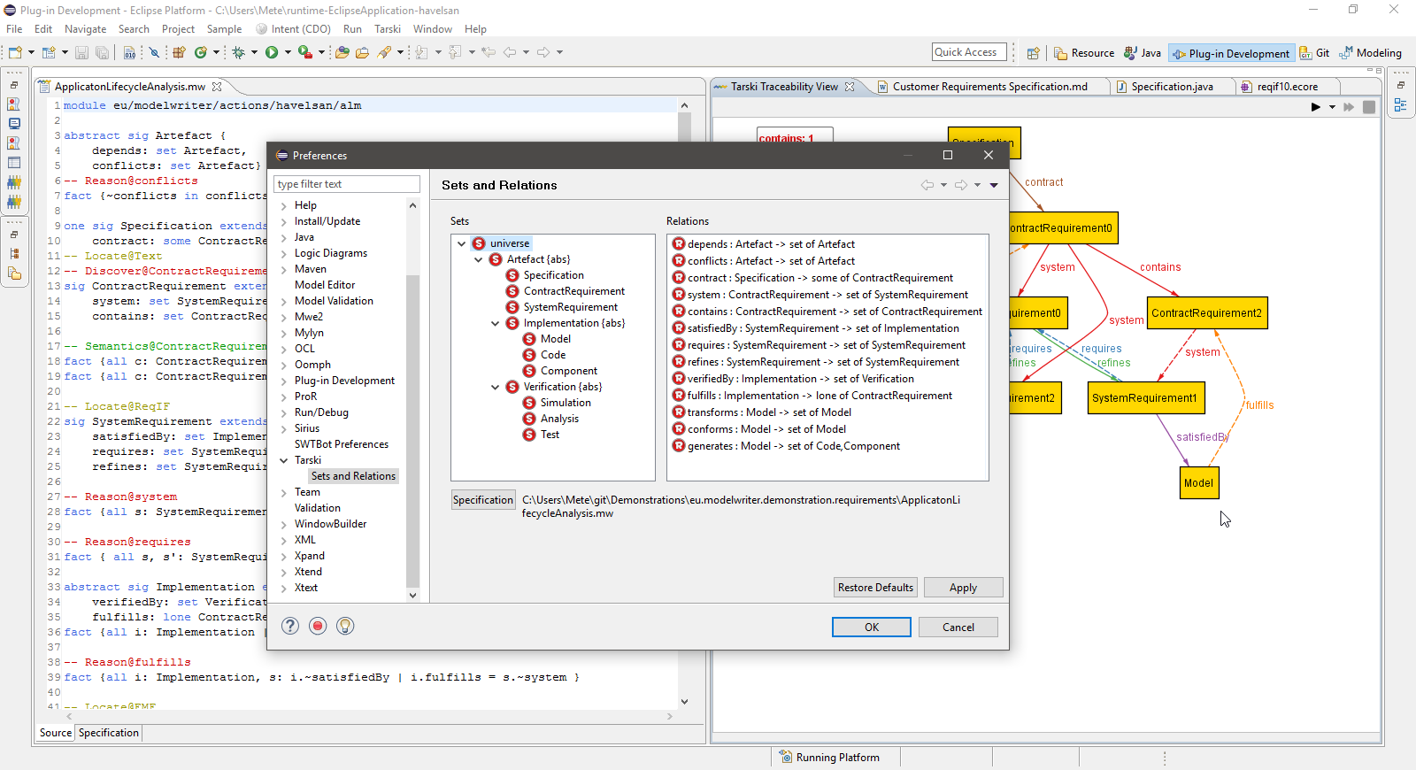
Types/Component Ontology derived from the specification
Notes:
Simplified version of actual architecture, there is a striking resemblance between planned and actual ones which means logical decomposition of project based on fucntions corresponds the real architecture.

Slide 11
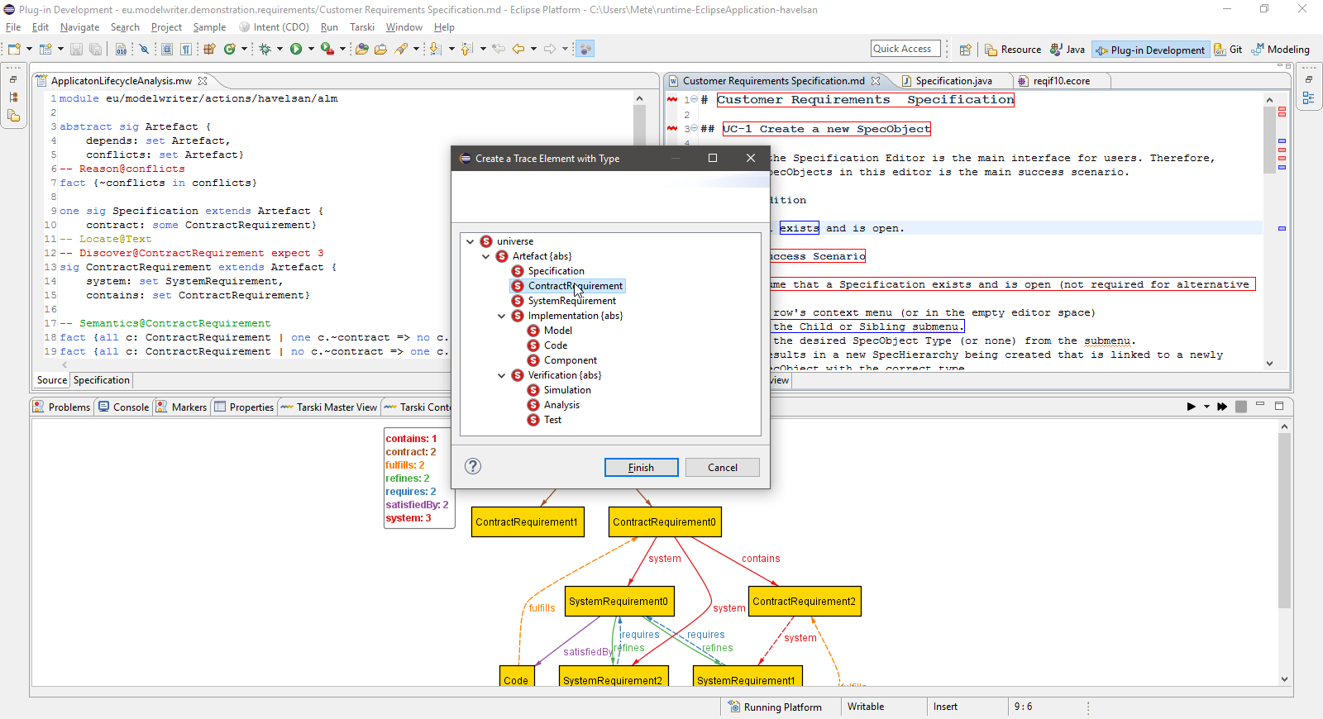
Assigning Unary Relations to a Traceable Elements
Notes:
Simplified version of actual architecture, there is a striking resemblance between planned and actual ones which means logical decomposition of project based on fucntions corresponds the real architecture.

Slide 12
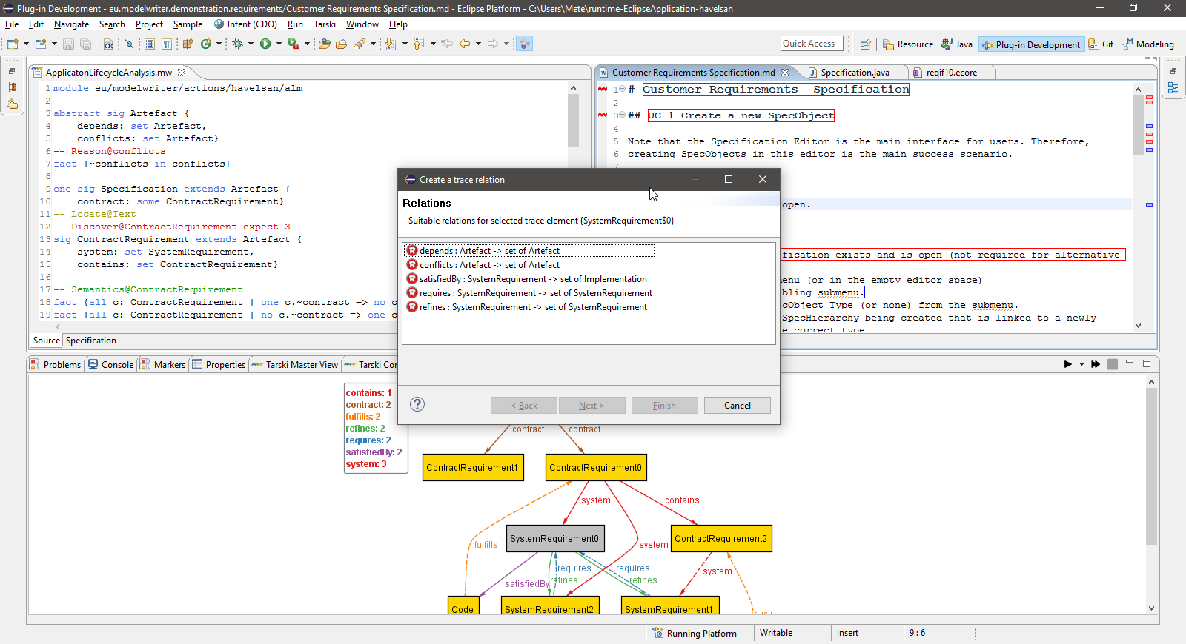
Assigning Binary Relations to a Trace Link
Notes:
Simplified version of actual architecture, there is a striking resemblance between planned and actual ones which means logical decomposition of project based on fucntions corresponds the real architecture.

Slide 13
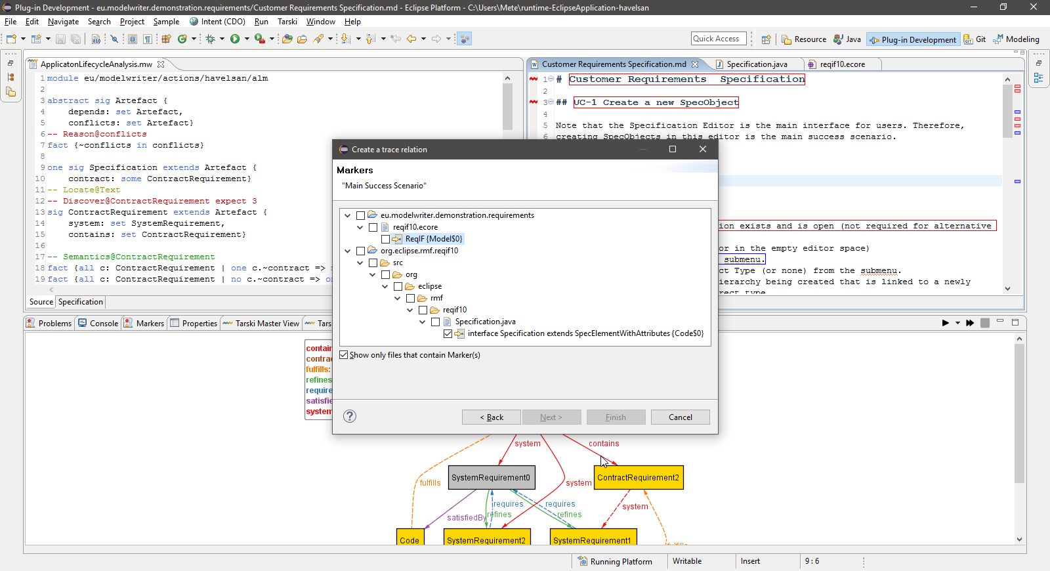
Selecting a range for a binary relation from an existing traceable elements
Notes:
Simplified version of actual architecture, there is a striking resemblance between planned and actual ones which means logical decomposition of project based on fucntions corresponds the real architecture.

Slide 14
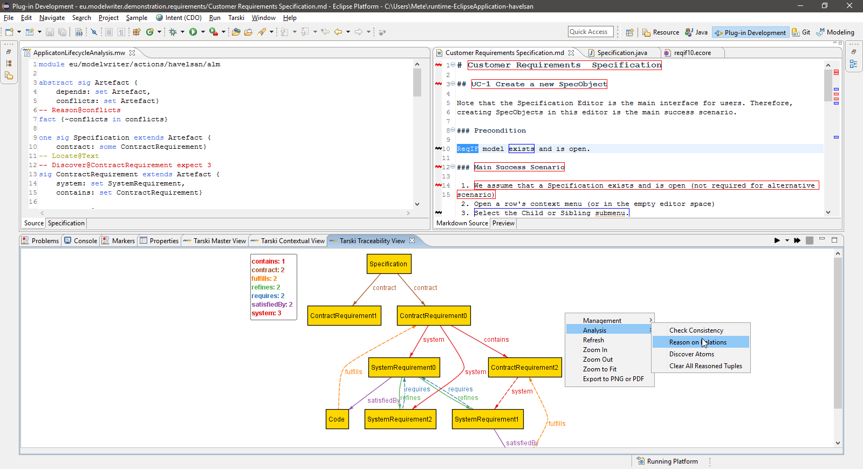
Automated Analysis of Traceability
Notes:
Simplified version of actual architecture, there is a striking resemblance between planned and actual ones which means logical decomposition of project based on fucntions corresponds the real architecture.

Slide 15
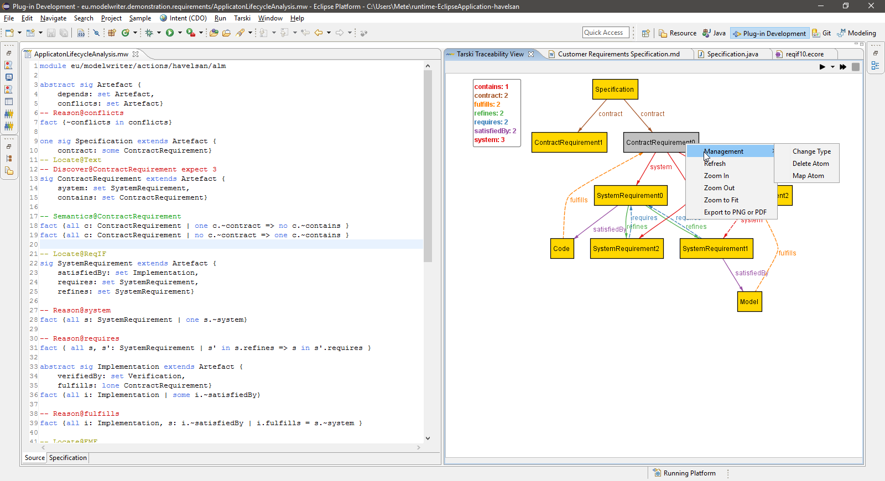
Dynamical Configuration & Model Management
Notes:
Simplified version of actual architecture, there is a striking resemblance between planned and actual ones which means logical decomposition of project based on fucntions corresponds the real architecture.

Slide 16
Validation of the Approach and Tool
Use Cases
(KocSistem & UNIT)
Airbus Group Innovation
SIDP: System Installation Design Principles
Havelsan Hava Elektronik Sanayi A.Ş.
Application Lifecycle Management (ALM)
Ford Otomotiv Sanayi A.Ş.
Product Lifecycle Management (PLM)
Software parts of body controller modules (BCM)
Daimler A.G.
Engine Design Specifications
Action research
(KocSistem & UNIT)
UC-TR-03
UC-TR-04
UC-TR-05
Validation of the Approach & Tool
Traceability between IBM Rational Doors – MatLab Simulink
Traceability among IBM Rational Doors – Design and Code

Slide 17
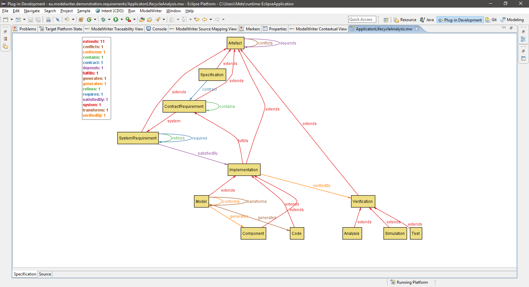
Demonstration Havelsan’s Formal Specification in Action

Slide 18
Formal Specification of Traceability (WP3) [UNIT]
Formal Specification of Traceability (WP3)
Load/Update Specification
Update signatures
Update facts and annotated facts
Eclipse-based Text Editor
Semantic Analysis
Error Reporting
Syntax Highlighting
Content Assists
Show all Trace Types
Custom annotations
Reason@relation
Trace@model
Locate@document
Load@model
Definition of Formal Semantics
Definition of Temporal Properties

Slide 19
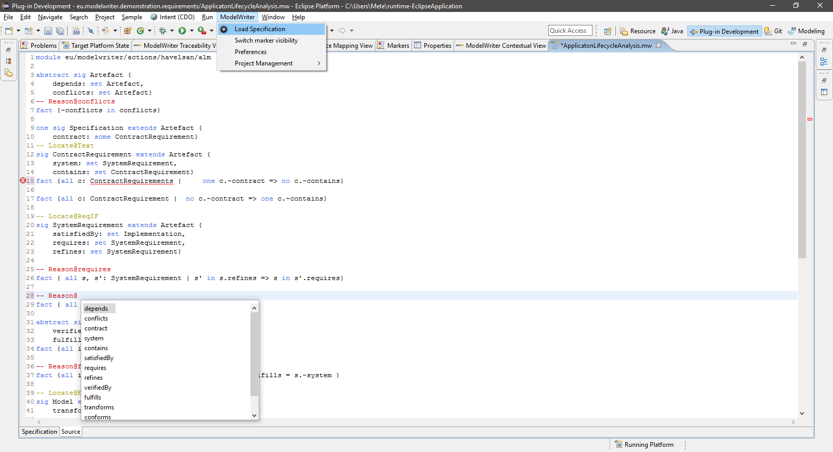
Demonstration Textual Editor in Action

Slide 20
Traceability Visualization/View (WP3) [KoçSistem]
Traceability Visualization (View)
Integration Alloy’s Simulation Screen
Support mutation on Alloy’s universe
Visual Improvements.
Integration with other components
Update Atom
Delete Atom
Delete Relation
Create Relation
Create Atom
Change Type
e.g. “Edge Crossing Minimization”
Dashed Lines
JGraph-based Visualization
To visualise EMF Instance
Highlighting Atoms and Relations

Slide 21
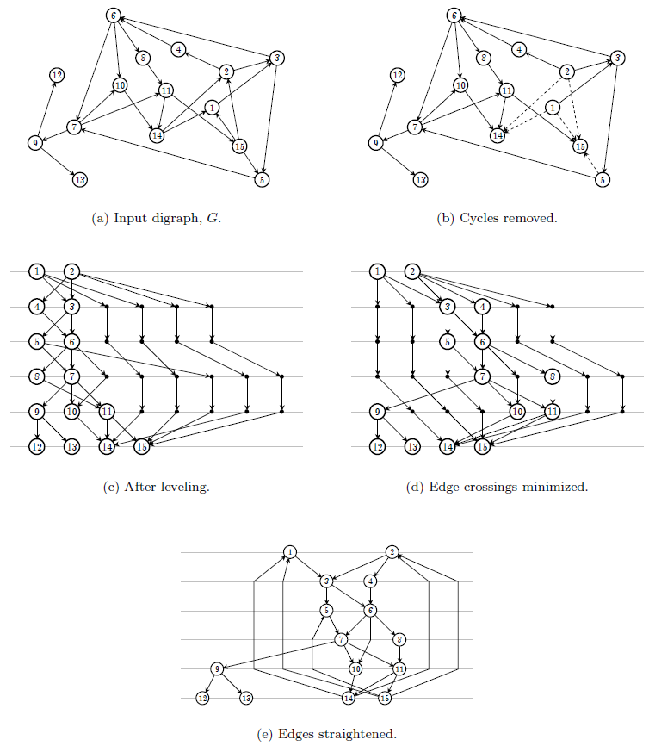
Layered/Hierarchical Graph Drawing Sugiyama Framework

Slide 22
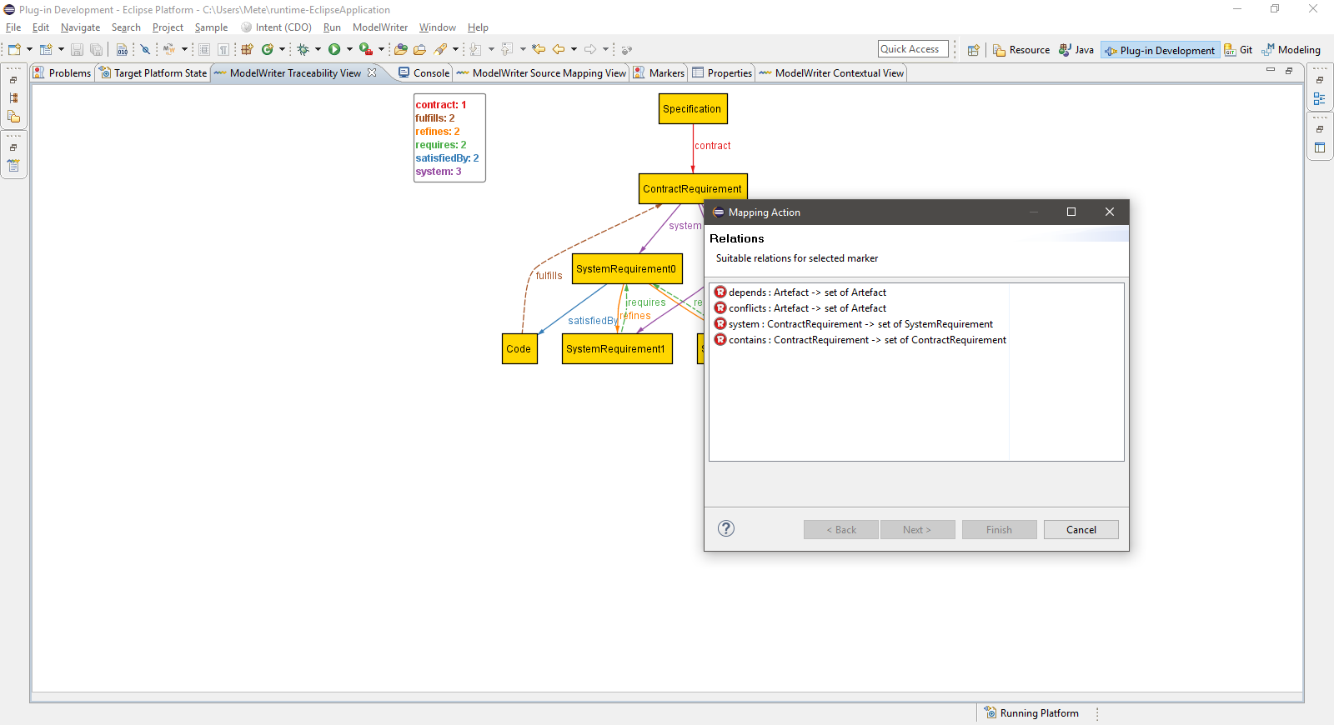
Demonstration Visualization in Action

Slide 23
Traceability Analysis (WP4 & WP3) [UNIT]
Traceability Analysis
Change Impact Analysis
Reasoning on relations
Consistency checking
Scalability
Automated Tracebility Link Creation
Automated Reasoning
Between Modeling Languages
Integration of Efficient Decision Procedures
Incremental Approach
Multi-Consistency Checking
Location discovery
Model Integration
Traceability Data-Model

Slide 24
Modeling and Reasoning Approaches (WP3) [UNIT]
Modeling and Reasoning
Constraint Solving (Bounded Model Checking)
KodKod: a constraint solver for relational logic
Theorem Provers
Z3: high performance therom prover
Consistency Checking
Crocopat: tool for efficient relational programming
SAT Solvers
SMT Solvers
Efficient Graph Algorithms
Alloy Analysis Engine
KodKod
Model Checking
NuXMV:a symbolic model checker
Finite State
SAT Solvers
Infinite State
SMT Solvers
First-order relational logc
The Satisfiability Modulo Theories Library (SMT-LIB)
Linear Temporal Logic (LTL)
KodKod: a constraint solver for relational logic
Exact Bounds

Slide 25
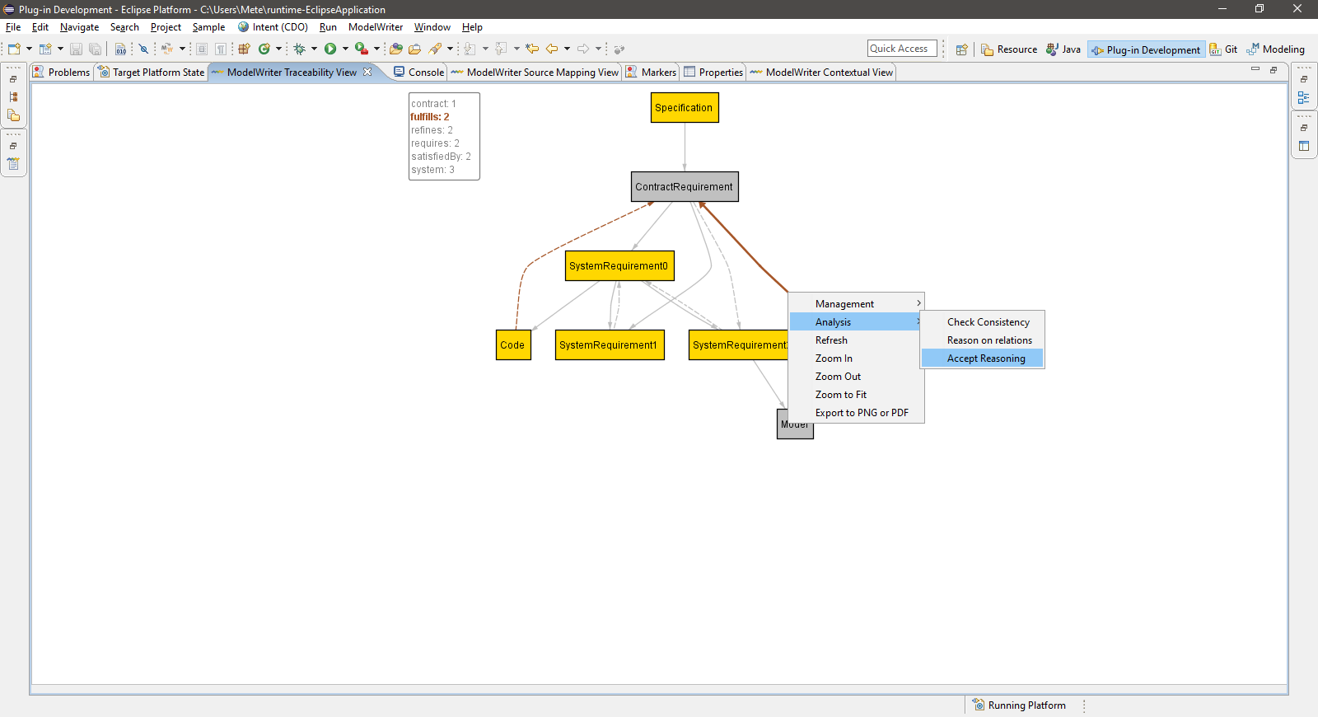
Demonstration Traceability Analysis in Action

Slide 26
Traceability Management (WP6) [KoçSistem]
Traceability Management
Eclipse Views
Traceability View
Contextual View
Target mapping
Source mapping
Eclipse Wizards
Mark w/ type
Eclipse Actions
Hyperlink detectors and menu
Drag and Drop
Supported Eclipse Editors
Navigation
Delete Mark
Map Marker
Remove
Change Type

Slide 27
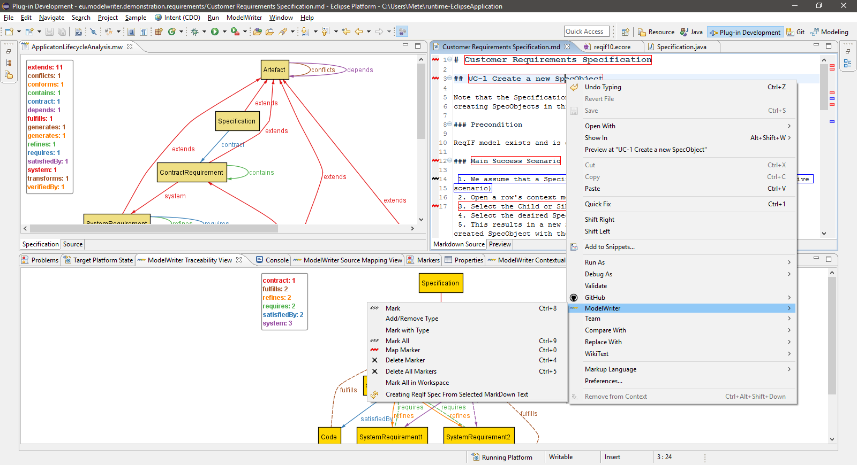
Demonstration Traceability Management in Action

Slide 28
Thank you for your attention We value your opinion and questions.

